Slide 1

Introduction to Asymptotic Analysis
Charles Aunkan Gomes
Lecturer, Dept. of CSE
United International University
Courtesy: Umama Rahman

Slide 2
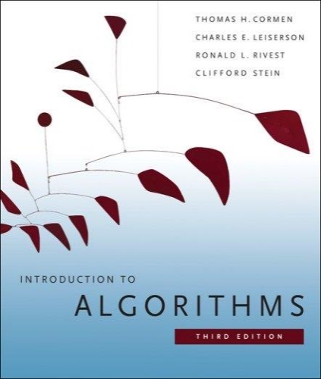
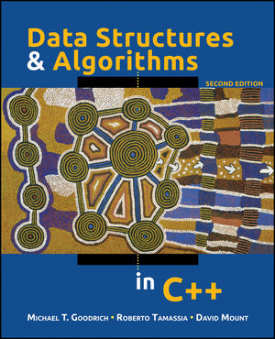
DSA
Introduction to Algorithms (Third edition)
  Cormen, Leiserson, Rivest, and Stein
  An excellent reference you should own
Data Structures and Algorithms in C++
  Goodrich, Tamassia, and Mount

Slide 3
What is an Algorithm?
An algorithm is a sequence of computational steps that solves a well-specified computational problem.
  An algorithm is said to be correct if, for every input instance, it halts with the correct output
  An incorrect algorithm might not halt at all on some input instances, or it might halt with other than the desired output.

Slide 4

What is a Program?
A program is the expression of an algorithm in a programming language
A set of instructions which the computer will follow to solve a problem

Slide 5
Define a Problem, and Solve It
Problem:
  Description of Input-Output relationship
Algorithm:
  A sequence of computational steps that transform the input into the output.
Data Structure:
  An organized method of storing and retrieving data.
Our Task:
  Given a problem, design a correct and good algorithm that solves it.

Slide 6
Define a Problem, and Solve It
Problem: Input is a sequence of integers stored in an array.
Output the minimum.
INPUT
Algorithm
OUTPUT
instance
m:= a[1];
for i:=2 to size of input
if m > a[i] then
m:=a[i];
return m
25, 90, 53, 23, 11, 34
11
m, a[i]
Data-Structure

Slide 7
What do we Analyze?
Correctness
  Does the input/output relation match algorithm requirement?
Amount of work done (complexity)
  Basic operations to do task
Amount of space used
  Memory used
Simplicity, clarity
  Verification and implementation.
Optimality
  Is it impossible to do better?

Slide 8
Running Time
Number of primitive steps that are executed
  Except for time of executing a function call most statements roughly require the same amount of time
    y = m * x + b
    c = 5 / 9 * (t - 32 )
    z = f(x) + g(y)
We can be more exact if need to be

Slide 9
Asymptotic Performance
We care most about asymptotic performance
  How does the algorithm behave as the problem size gets very large?
    Running time
    Memory/storage requirements
    Bandwidth/power requirements/logic gates/etc.

Slide 10
Asymptotic Analysis
Worst case
  Provides an upper bound on running time
  An absolute guarantee of required resources
Average case
  Provides the expected running time
  Very useful, but treat with care: what is “average”?
    Random (equally likely) inputs
    Real-life inputs
Best case
  Provides a lower bound on running time

Slide 11
Upper Bound Notation
We say Insertion Sort's run time is O(n²)
  Properly we should say run time is in O(n²)
  Read O as “Big-Oh” (you’ll also hear it as “order”)
In general a function
  f(n) is O(g(n)) if there exist positive constants c and n₀ such that 0 ≤ f(n) ≤ c ⋅ g(n) for all n ≥ n₀
Formally
  O(g(n)) = { f(n): ∃ positive constants c and n₀ such that
  0 ≤ f(n) ≤ c ⋅ g(n) ∀ n ≥ n₀ }

Slide 12
Upper Bound Notation
time
c.g(n)
f(n)
n
n₀
We say g(n) is an asymptotic upper bound for f(n)

Slide 13
Lower Bound Notation
We say InsertionSort’s run time is Ω(n) (big-omega or just omega)
In general a function
  f(n) is Ω(g(n)) if ∃ positive constants c and n₀ such that
  0 ≤ c⋅g(n) ≤ f(n) ∀ n ≥ n₀
Proof:
  Suppose run time is an + b
    Assume a and b are positive
  an ≤ an + b

Slide 14
Lower Bound Notation
time
f(n)
c.g(n)
n
n₀
We say g(n) is an asymptotic lower bound for f(n)

Slide 15
Asymptotic Tight Bound
A function f(n) is Θ(g(n)) if ∃ positive constants c₁, c₂, and n₀ such that
0 ≤ c₁ g(n) ≤ f(n) ≤ c₂ g(n) ∀ n ≥ n₀
Theorem
  f(n) is Θ(g(n)) iff f(n) is both O(g(n)) and Ω(g(n))

Slide 16
Asymptotic Tight Bound
time
c₂.g(n)
f(n)
c₁.g(n)
n
n₀
We say g(n) is an asymptotic tight bound for f(n)

Slide 17
Asymptotic Notation
O notation: asymptotic “less than”:
  f(n)=O(g(n)) implies: f(n) “≤” g(n)
Ω notation: asymptotic “greater than”:
  f(n)= Ω (g(n)) implies: f(n) “≥” g(n)
Θ notation: asymptotic “equality”:
  f(n)= Θ (g(n)) implies: f(n) “=” g(n)

Slide 18
Practical Complexity
Function | Descriptor | Big-Oh
c | Constant | O( 1 )
log n | Logarithmic | O( log n )
n | Linear | O( n )
n log n | n log n | O( n log n )
n² | Quadratic | O( n² )
n³ | Cubic | O( n³ )
n^{k} | Polynomial | O( n^{k} )
2^{n} | Exponential | O( 2^{n} )
n! | Factorial | O( n! )

Slide 19
Practical Complexity
For large input sizes, constant terms are insignificant
Program A with running time T_{A}(n)= 100n
Program B with running time T_{B}(n)= 2n²
T_{P}(n)
T_{B}(n) = 2n²
T_{A}(n) = 100n
5000
Input Size n
50
Notes:
19

Slide 20
Analysis of Algorithms
What is the goal of analysis of algorithms?
  To compare algorithms mainly in terms of running time but also in terms of other factors (e.g., memory requirements, programmer’s effort etc.)
What do we mean by running time analysis?
  Determine how running time increases as the size of the problem increases.

Slide 21
Input Size
Input size (number of elements in the input)
  size of an array
  # of elements in a matrix
  # of bits in the binary representation of the input
  vertices and edges in a graph

Slide 22
How do we compare algorithms?
(1) Compare execution times?
Not good: times are specific to a particular computer !!
(2) Count the number of statements executed?
Not good: number of statements vary with the programming language as well as the style of the individual programmer.

Slide 23
Ideal Solution
Express running time as a function of the input size n (i.e., f(n)).
Compare different functions corresponding to running times.
Such an analysis is independent of machine time, programming style, etc.

Slide 24
Rate of Growth
The low order terms in a function are relatively insignificant for large n
n⁴ + 100n² + 10n + 50 ~ n⁴
i.e., we say that n⁴ + 100n² + 10n + 50 and n⁴ have the same rate of growth

Slide 25
Big-O Notation
We say f_{A}(n)=30n+8 is order n, or O(n)
It is, at most, roughly proportional to n.
f_{B}(n)=n²+1 is order n², or O(n²). It is, at most, roughly proportional to n².
In general, any O(n²) function is faster- growing than any O(n) function.

Slide 26
Example
Associate a "cost" with each statement.
Find the "total cost“ by finding the total number of times each statement is executed.
Algorithm 1 Cost Algorithm 2 Cost
arr[0] = 0; c₁ for(i=0; i<N; i++) c₂
arr[1] = 0; c₁ arr[i] = 0; c₁
arr[2] = 0; c₁
... ...
arr[N-1] = 0; c₁
----------- -------------
c₁+c₁+...+c₁ = c₁ x N (N+1) x c₂ + N x c₁ = (c₂ + c₁) x N + c₂
Both algorithms are of the same order: O(N)

Slide 27
Another Example
Algorithm 3 Cost
sum = 0; c₁
for(i=0; i<N; i++) c₂
for(j=0; j<N; j++) c₂
sum += arr[i][j]; c₃
------------
c₁ + c₂ x (N+1) + c₂ x N x (N+1) + c₃ x N² = O(N²)

Slide 28
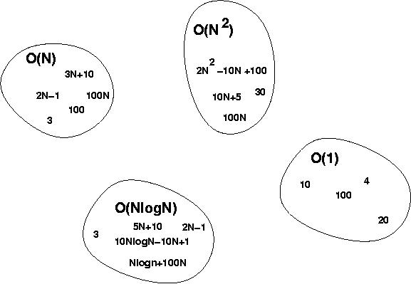
Big-O Visualization
O(g(n)) is the set of functions with smaller or same order of growth as g(n)

Slide 29
More Examples …
n⁴ + 100n² + 10n + 50 is O(n⁴)
10n³ + 2n² is O(n³)
n³ - n² is O(n³)
2n² = O(n³)
n² = O(n²)
1000n²+1000n = O(n²)
n = O(n²)
constants
  10 is O(1)
  1273 is O(1)

Slide 30
Examples of big-omega
  5n² = Ω(n)
  100n + 5 ≠ Ω(n²)
  n = Ω(n), n³ = Ω(n²), n = Ω(logn)
  ∃ c, n₀ such that: 0 ≤ cn ≤ 5n²
⇒ c = 5 and n₀ = 1
⇒ cn ≤ 5n²

Slide 31
Relations Between Different Sets
Subset relations between order-of-growth sets.
R→R
O(f)
Ω(f)
Θ(f)

Slide 32
Examples of theta notation
  f(n) = n²/2 – n/2 = Θ(n²)
    We can express f(n) = O(n²) and f(n) = Ω(n²)
  f(n) = 6n³ ≠ Θ(n²)
    6n³ ≠ O(n²) even though 6n³ = Ω(n²)
  logn ≠ Θ(n)
    logn = O(n) but logn ≠ Ω(n)

Slide 33


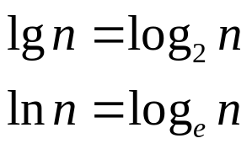


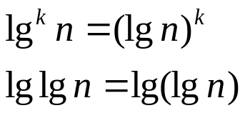
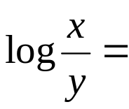




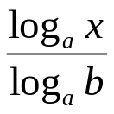
Logarithms and properties
In algorithm analysis we often use the notation “log n” without specifying the base
Binary logarithm
Natural logarithm
$$1<logn< \sqrt{n }<n<nlogn<n^{2}< n^{2}logn<n^{3 }< …< 2^{n }< 3^{n }<…<n^{n}$$
Charles Aunkan Gomes (Lecturer, Dept of CSE, UIU)

Slide 34
More Examples
For each of the following pairs of functions, either f(n) is O(g(n)), f(n) is Ω(g(n)), or f(n) = Θ(g(n)). Determine which relationship is correct.
  f(n) = log n²; g(n) = log n + 5
  f(n) = n; g(n) = log n²
  f(n) = log log n; g(n) = log n
  f(n) = n; g(n) = log² n
  f(n) = n log n + n; g(n) = log n
  f(n) = 10; g(n) = log 10
  f(n) = 2^{n}; g(n) = 10n²
  f(n) = 2^{n}; g(n) = 3^{n}
f(n) = Θ (g(n))
f(n) = Ω(g(n))
f(n) = O(g(n))
f(n) = Ω(g(n))
f(n) = Ω(g(n))
f(n) = Θ(g(n))
f(n) = Ω(g(n))
f(n) = O(g(n))

Slide 35
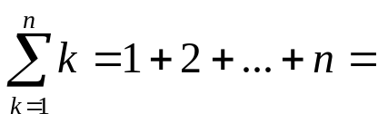
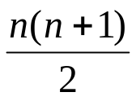
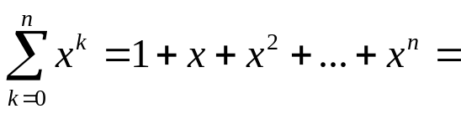
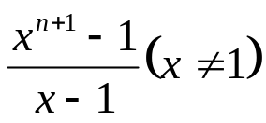
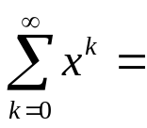
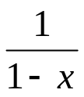
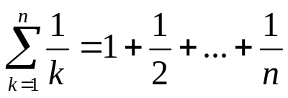

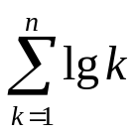

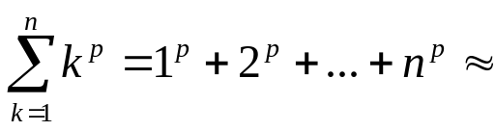
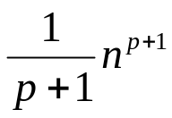
Common Summations
Arithmetic series:
Geometric series:
  Special case: |x| < 1:
Harmonic series:
Other important formulas:
Charles Aunkan Gomes (Lecturer, Dept of CSE, UIU)

Slide 36
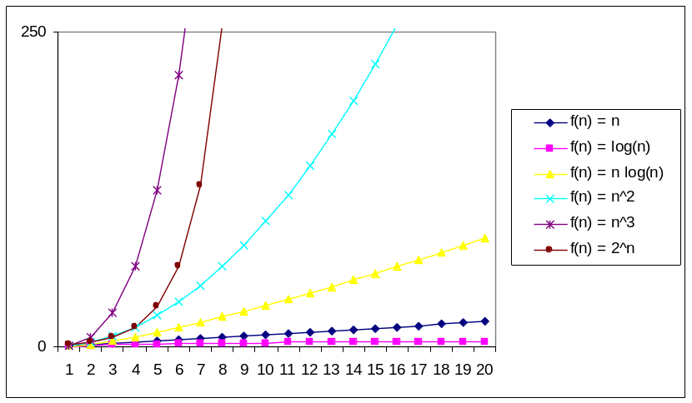
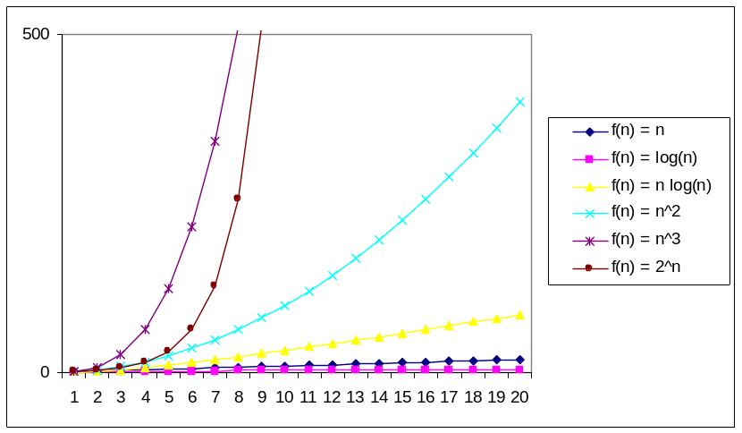
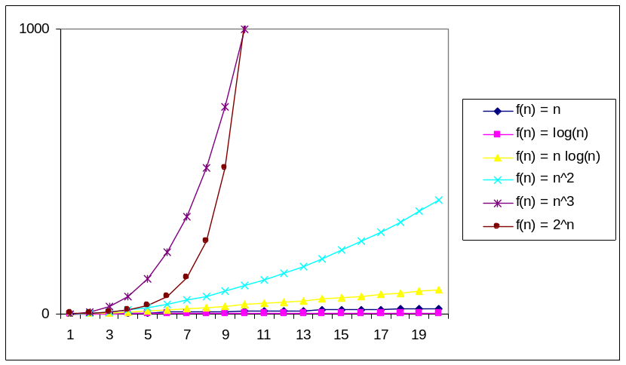
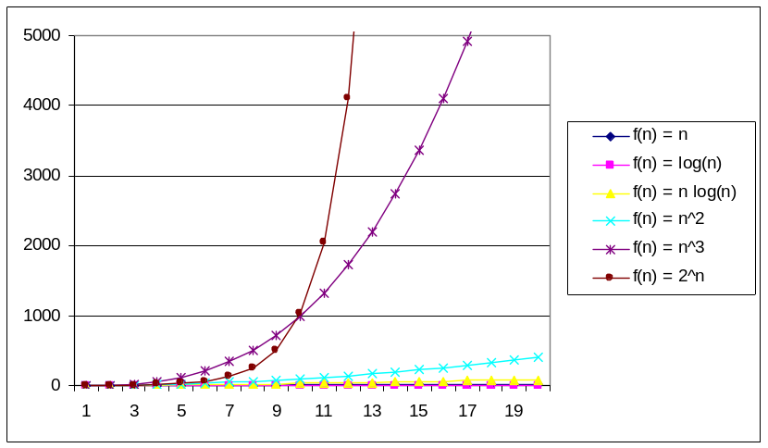
Practical Complexity

Slide 37
Other Asymptotic Notations
A function f(n) is o(g(n)) if ∃ positive constants c and n₀ such that
f(n) < c g(n) ∀ n ≥ n₀
A function f(n) is ω(g(n)) if ∃ positive constants c and n₀ such that
c g(n) < f(n) ∀ n ≥ n₀
Intuitively,
  o( ) is like <
  O( ) is like ≤
  ω( ) is like >
  Ω( ) is like ≥
  Θ( ) is like =

Slide 38


